Slide 1
Raspberry Pi-LoRa
Vignesh Purushotham Srinivas
Henrik Cassé
Amit Choudhary

Slide 2
Introduction
Background
The goal of IoT is to connect and communicate the wireless sensing devices based on the IoT application requirements such as measure the real time temperature, humidity, air quality monitor and wireless power transfer. The connectivity solutions characterize on the bases of key parameters such as coverage distance, spectrum and performance.
Short area coverage sensor networks use for indoor IoT solutions support bluetooth, ANT+ and MiWi and outdoor wide area uses the unlicensed LPWA coverage supports SIGIFOX, LoRa/LoRaWAN and licensed NB-IoT, LTE-M etc. for the connectivity solutions.
LPWAN provide long life battery and specifically used for the sensor and applications that send small packets of data covering the long distance. LoRaWAN operates on almost all the network topology for communication between LoRa gateways and IoT device
LoRa is LPWAN wireless communication radio whose approximation range is in between 2-5 km for urban area , 5-15 km for rural area and more than 15 km for direct line of sight and approximate Tx power is 20 mW. LoRa has very small data packets.
Whereas Bluetooth is a short-range wireless communication whose approximate range is 10m and approximate Tx power is 2.5 mW.
cont..

Slide 3
Introduction
Objective:
Designing and implementing a mesh network based on LoRA radio using simple temperature sensors and Raspberry Pi computers.
Description of the problem:
The focus of this project is to find the answers of under mentioned questions:
Setup the LoRa modules for collecting the temperature measurements
Setup the communication between two LoRa modules
Organize the mesh network using the Raspberry Pi and forward data to primary node. Present temperature data regularly on display.
Publish the data from mesh network to webserver.
Measure the range of LoRa and compare to models/data and compare the results with BLE project data
cont..

Slide 4
Introduction
Delimitations:
As of now, we have yet to satisfy out goal of an grade A. We have however, satisfied up to grade C. One of the things that have limited us have been the geographical distance between us.
Because of it (and the fact that one of our group members became sick) we have yet to perform the outdoor range tests. This of course also puts an limitation on our test results.
Other than there were some technical challenges to get the ssh service up and running on the Raspberry- Pi’s.

Slide 5
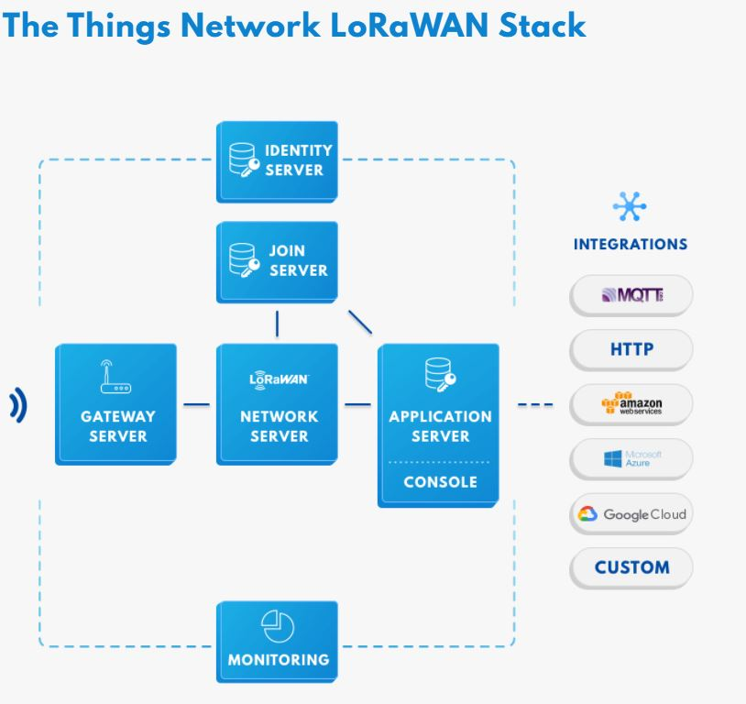
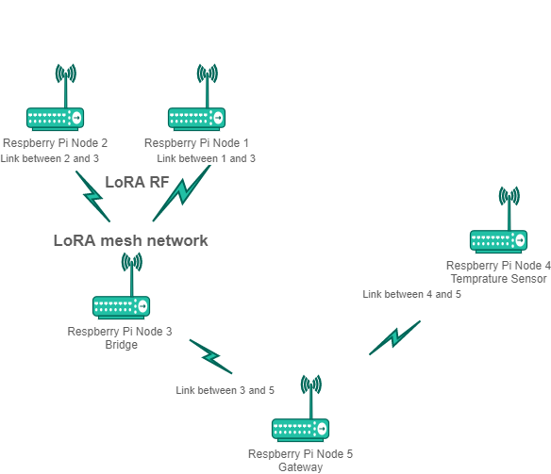
IoT System Architecture and Components

Slide 6
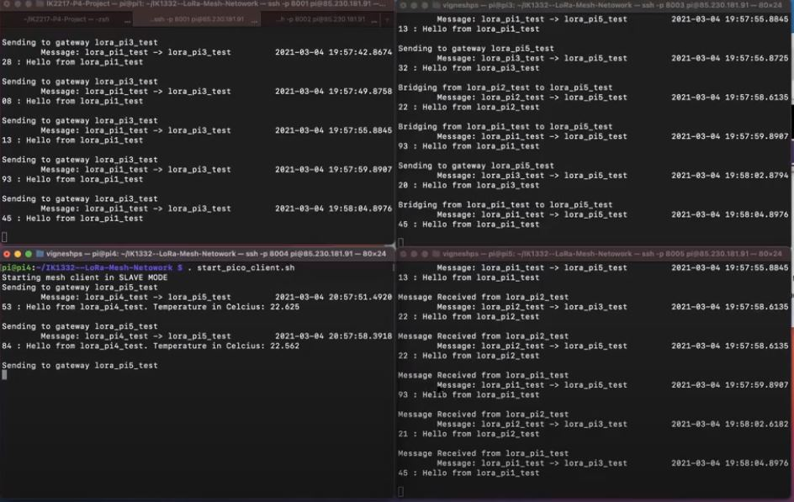
IoT System Architecture and Components
Terminal output

Slide 7
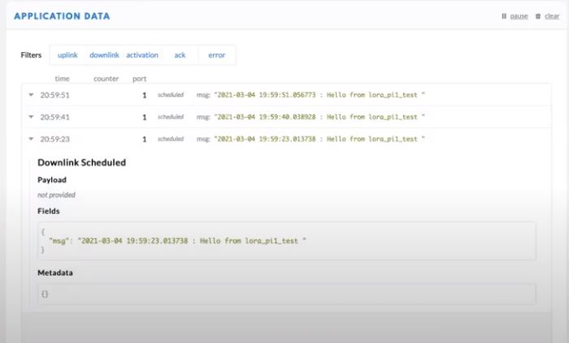
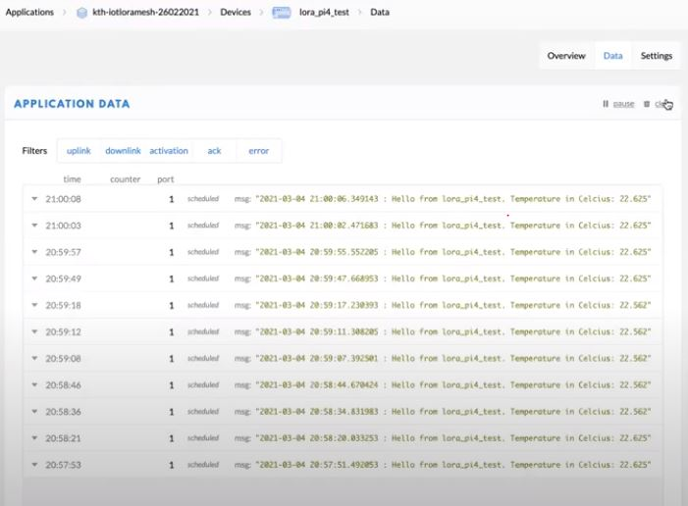
IoT System Architecture and Components
TTN application data output

Slide 8
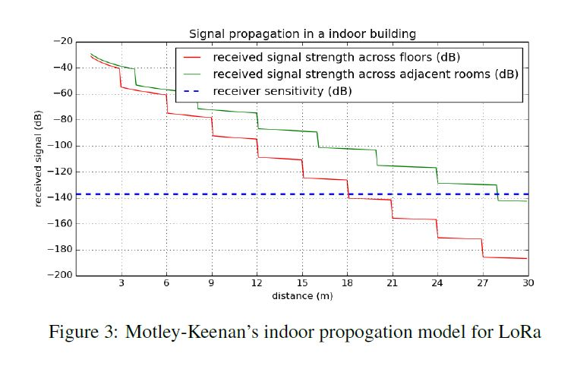
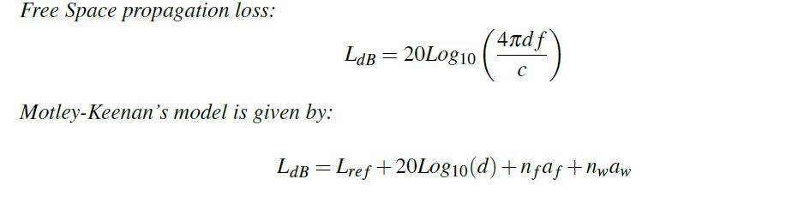
Design and implementation of sensor network
Indoor propagation modeling is based on Motley-Keenan’s model
cont..

Slide 9
Design and implementation of sensor network
Outdoor propagation modeling for the range of LoRa transmitters in outdoor environments, use Radio Frequency (RF) planning tool, cloudRF with Irregular Terrain Model (ITM).
Table shows the sx1276 modem settings to achieve the longest possible range
Parameters | Value
LoRa Module | Dragino v1.0 LoRa Hat with sx1276
TX Power | 14dBm
Frequency | 868MHz
Bandwidth | 125MHz
Spreading Factor | 12
Coding Rate | 4/5
cont..

Slide 10
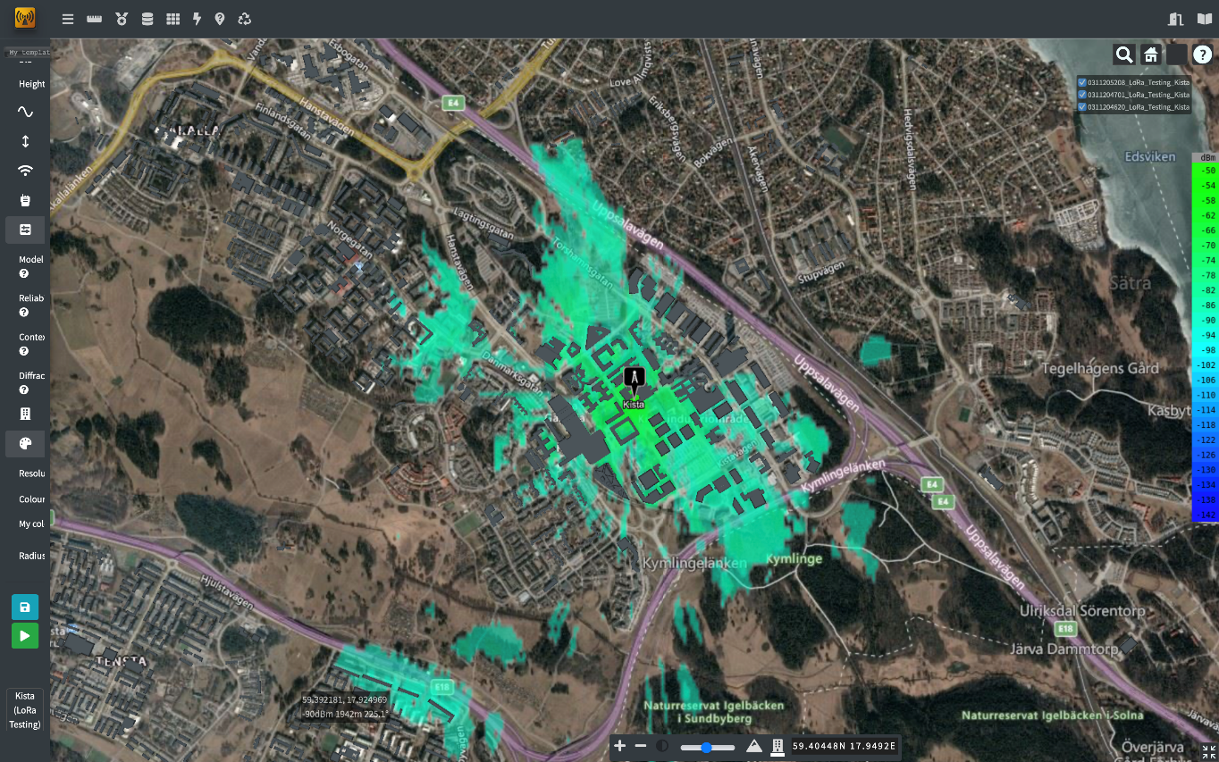
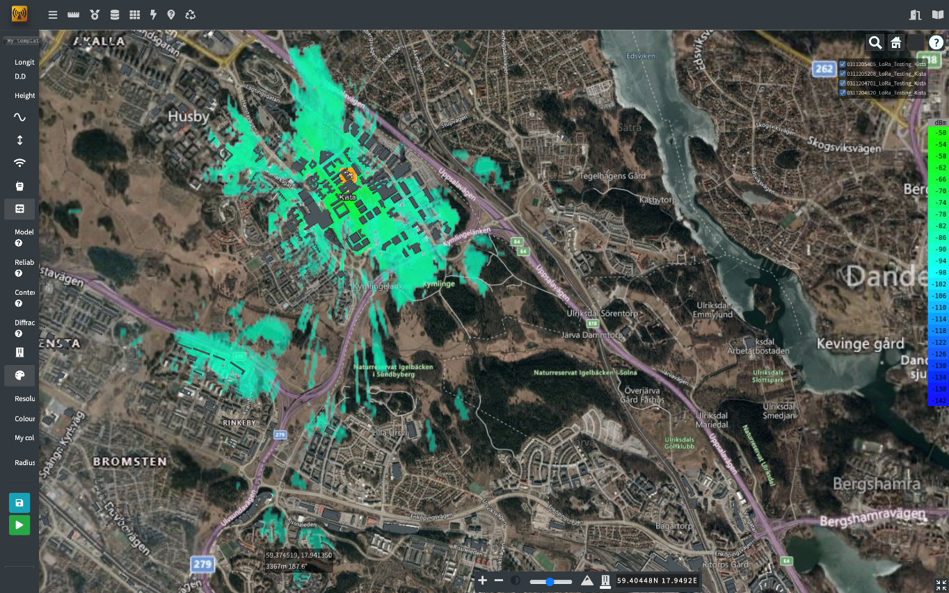
Design and implementation of sensor network

Slide 11
Results
We summarize the results of the above experiments. In indoor environments, LoRa can achieve a range of 18m vertically across multiple floors, and 28m horizontally across adjacent rooms. However, in outdoor settings, an optimistic range of 3.5 km can be achieved in sub-urban environments. LoRa suffers a great loss in indoor environments due to attenuation by various materials, and multipath fading. In outdoor environments, the primary factor of signal loss is signal scattering due to obstacles. However, LoRa can achieve higher ranges when the transmitter antennas are placed at higher altitudes. LoRa mesh networks can enable deployments with a coverage area of several tens of kilometers. Such networks scale linearly with the number of bridge networks that are present in the network.
When compared to the Bluetooth Mesh network, LoRa is can provide higher ranges, mainly owning to the use of chip sequences. Bluetooth networks can provide an outdoor average range of 15m. Such networks are ideal for dense indoor deployments where higher data rates are required, while LoRa networks are ideal for low data rates and outdoor deployments.
Code git repo :
https://gits-15.sys.kth.se/vips/IK1332-Lora-Mesh-Network

Slide 12
Conclusion
The work has, in conclusion, been going very well for us. There is really nothing we would have done differently. We did miss some meetings, but the work went very well, and the workflow was really smooth. Because of the very low cost to setup the LoRa network (in our case, we used four Raspberry Pi’s and some add-ons), which is very cheap. Also, it is possible to use only two Pi’s that communicate with each other. There really is no ethical or social aspect about our work.
As for the environmental aspect, because the parts in the project are small and lightweight, they do not require much material to make. This is obviously an advantage in the environmental aspect.

Slide 13
Thank You

